Slide 1
Putting loops into practice: Illumina data cleaning
1. Illumina data format
2. Illumina data quality assessment
3. Illumina data quality filtering

Slide 2
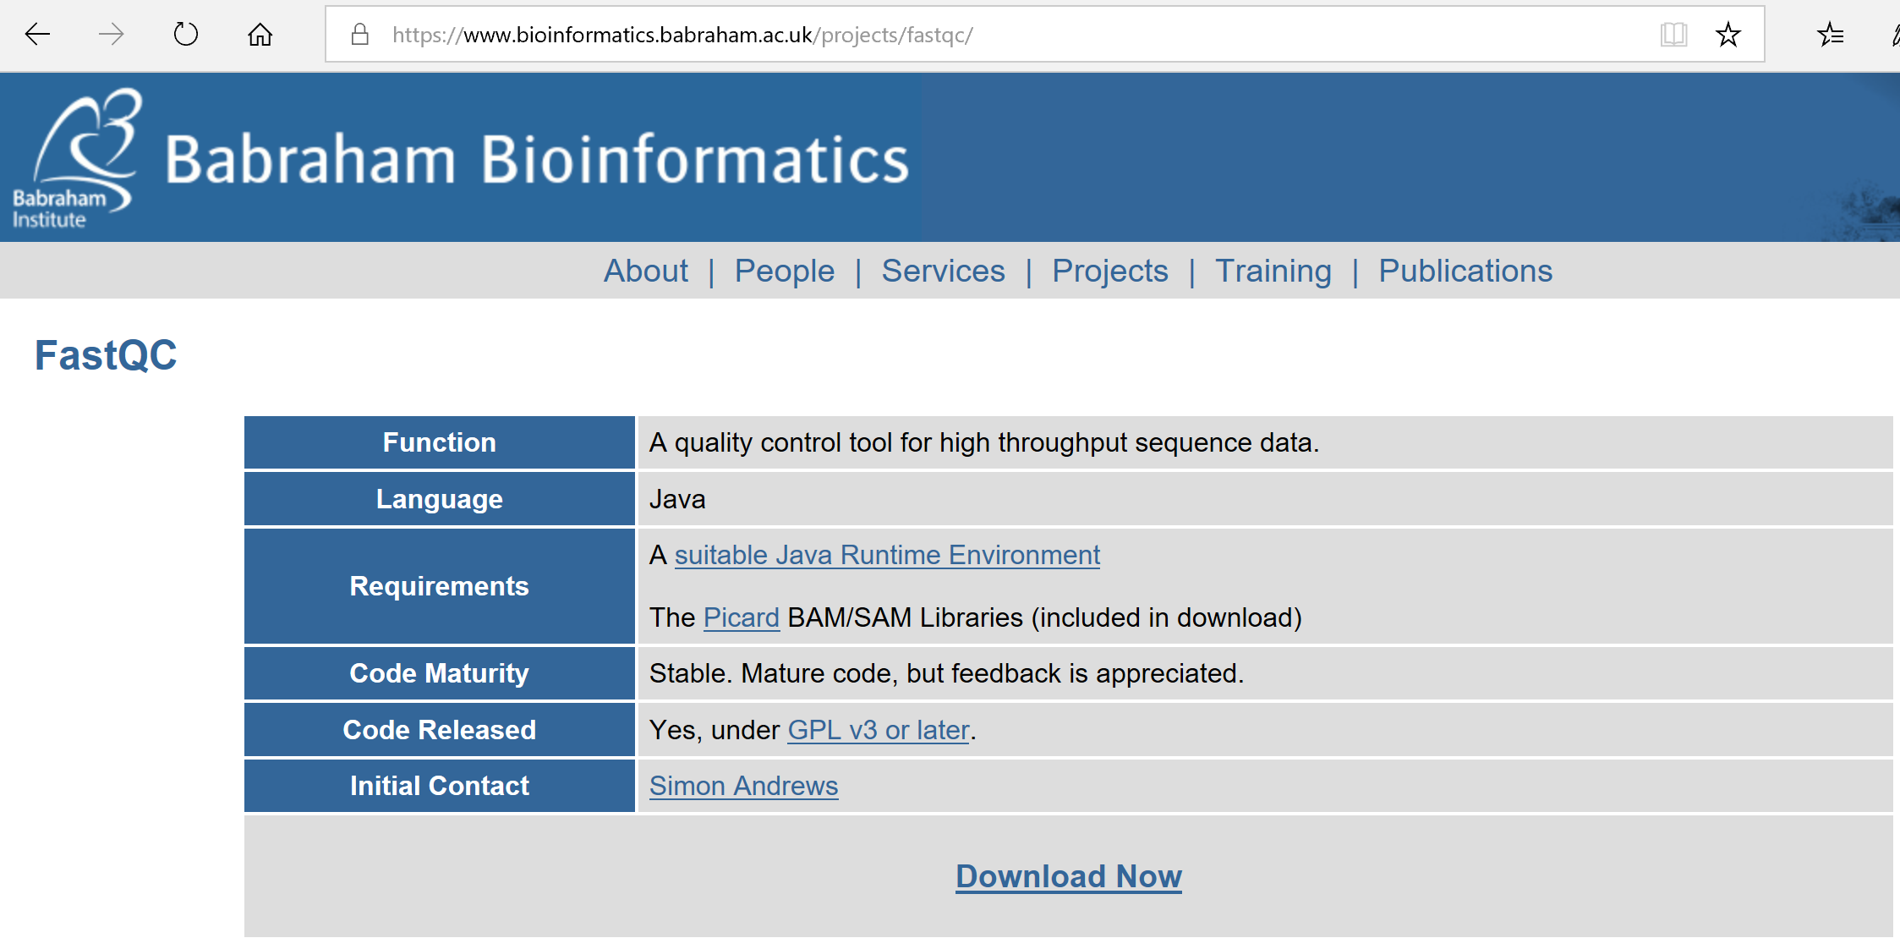
Assessing Illumina data quality with FastQC

Slide 3
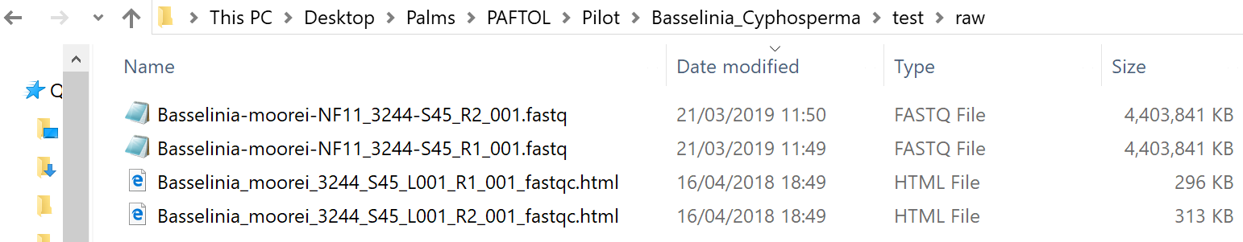
Running FastQC on one data file generates an html output file and possibly other files depending on the option specified

Slide 4
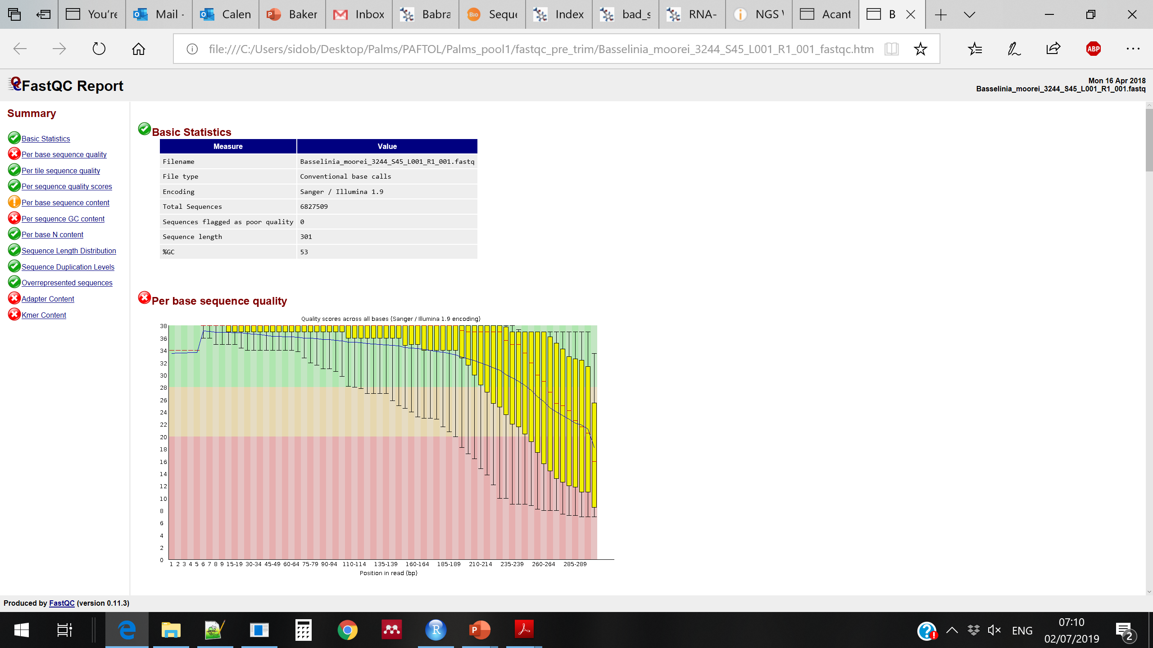
Running FastQC on one data file generates an html output file and possibly other files depending on the option specified

Slide 5
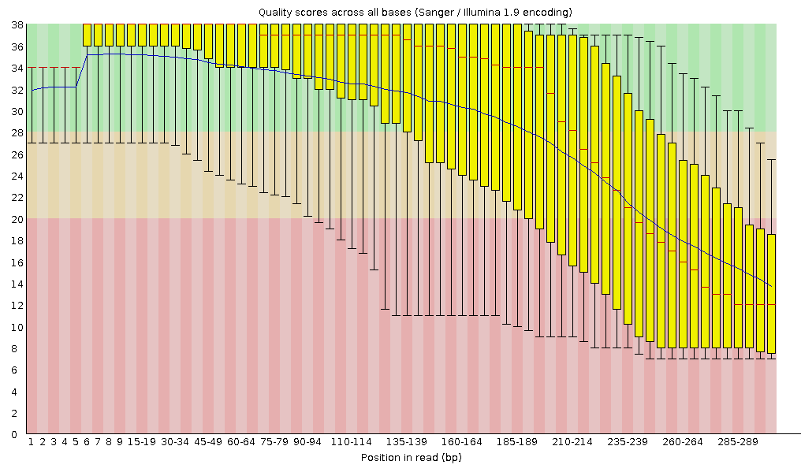
Running FastQC on one data file generates an html output file and possibly other files depending on the option specified
R1
R2

Slide 6
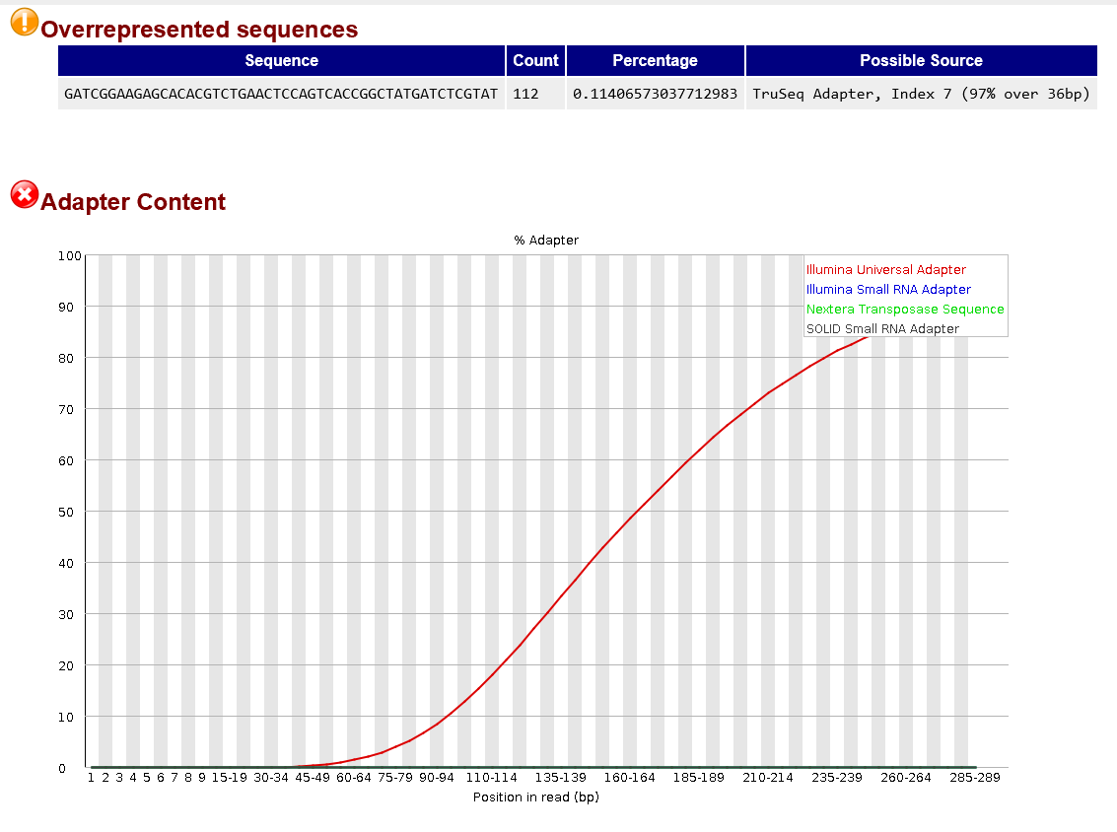

Slide 7

Exercise: Check the quality of your data with FastQC (1)
How can we know how to run a program? Find this information for FastQC
What should be the command to run FastQC on the R1 file of your first sample?
Run the command: what is happening? What should we do first?
Change permissions on fastqc
Run again the command
Remove the results

Slide 8
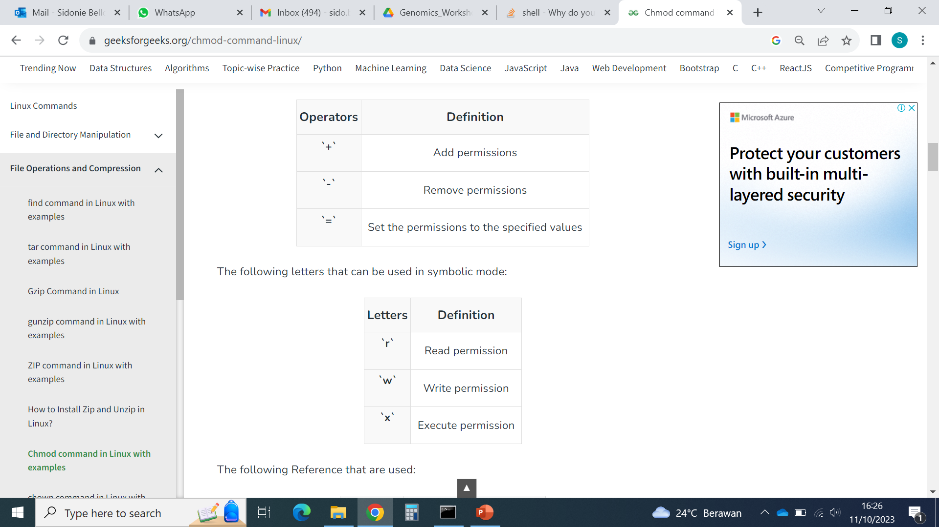
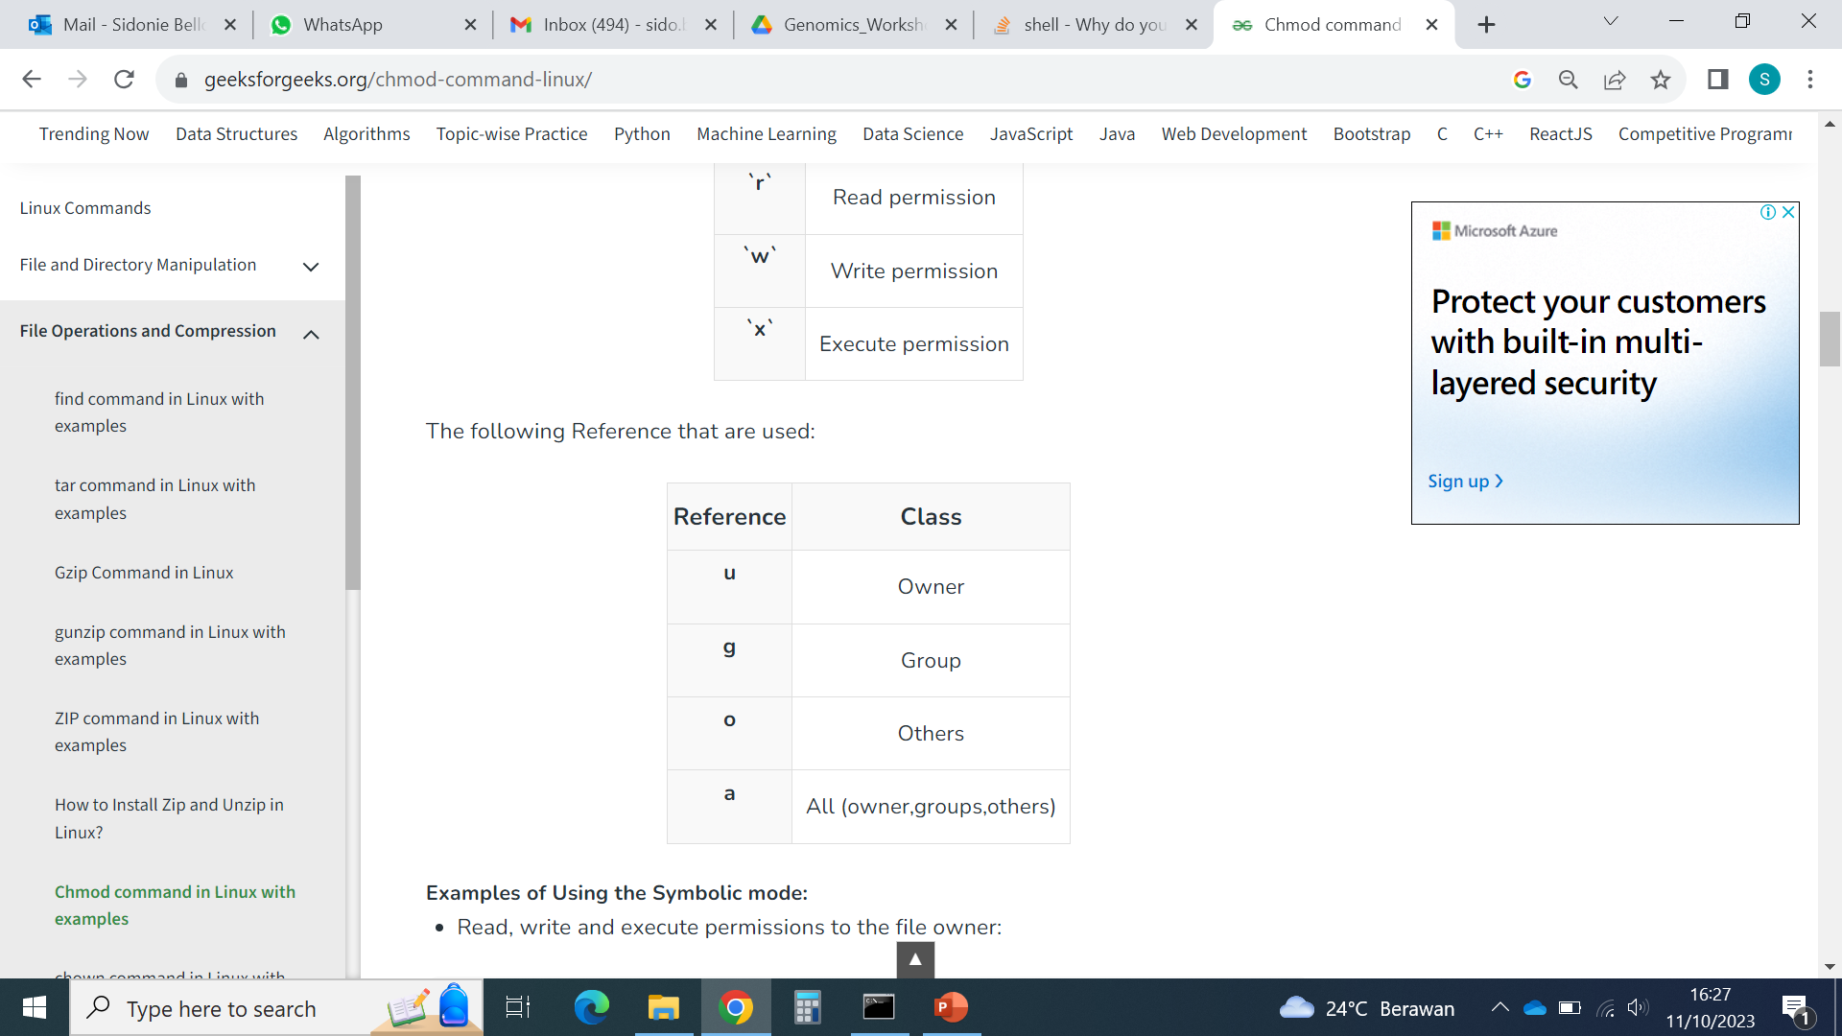
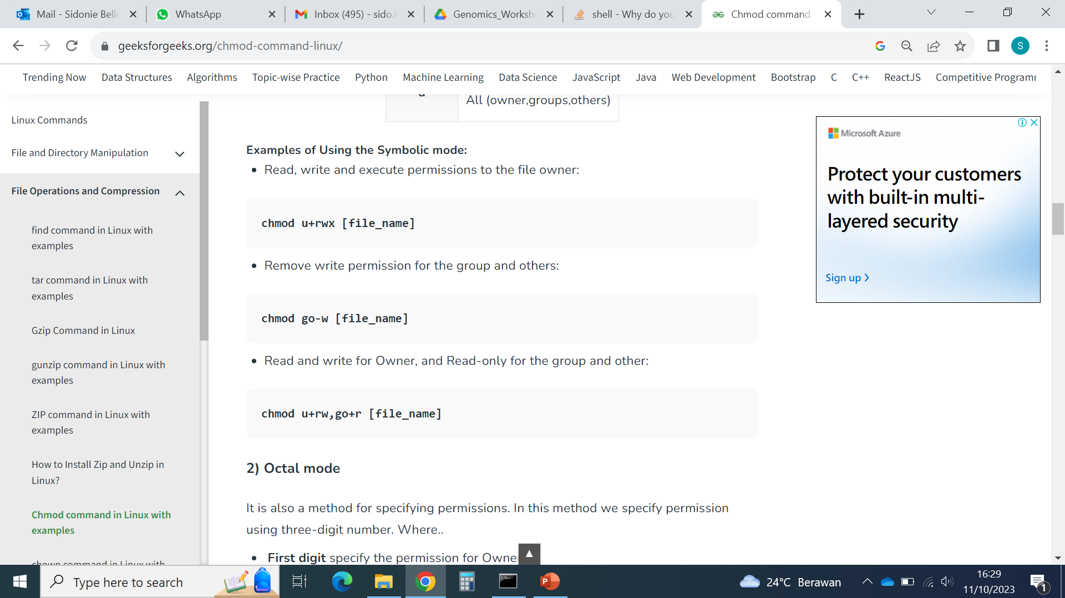
Changing file permissions: chmod
The chmod command allows to change the permissions given to different users to Read, Write and eXecute a file.
We need to tell chmod what permissions to modify, in what direction, and for what user(s) using symbols:
Examples:
https://www.geeksforgeeks.org/chmod-command-linux/

Slide 9

Solution: Check the quality of your data with FastQC (1)
How can we know how to run a program? Find this information for FastQC
Check the manual
What should be the command to run FastQC on the R1 file of your first sample?
fastqc sample1_R1.fastq
Run the command: what is happening? What should we do first?
Change permissions on fastqc
chmod a+rwx fastqc
Run again the command
./fastqc sample1_R1.fastq
Remove the results
rm *.html

Slide 10
Exercise: Check the quality of your data with FastQC (2)
What should be the command to run FastQC on all your samples?
(hint: use a for loop)
Run it
Is it good quality data?
What should be done to improve the quality of the data? (Take note of it)

Slide 11
Solution: Check the quality of your data with FastQC (2)
What should be the command to run FastQC on all your samples? (hint: use a for loop)
Run it
for f in *.fastq; do (./fastqc $f); done
Is it good quality data?
What should be done to improve the quality of the data? (Take note of it)

Slide 12
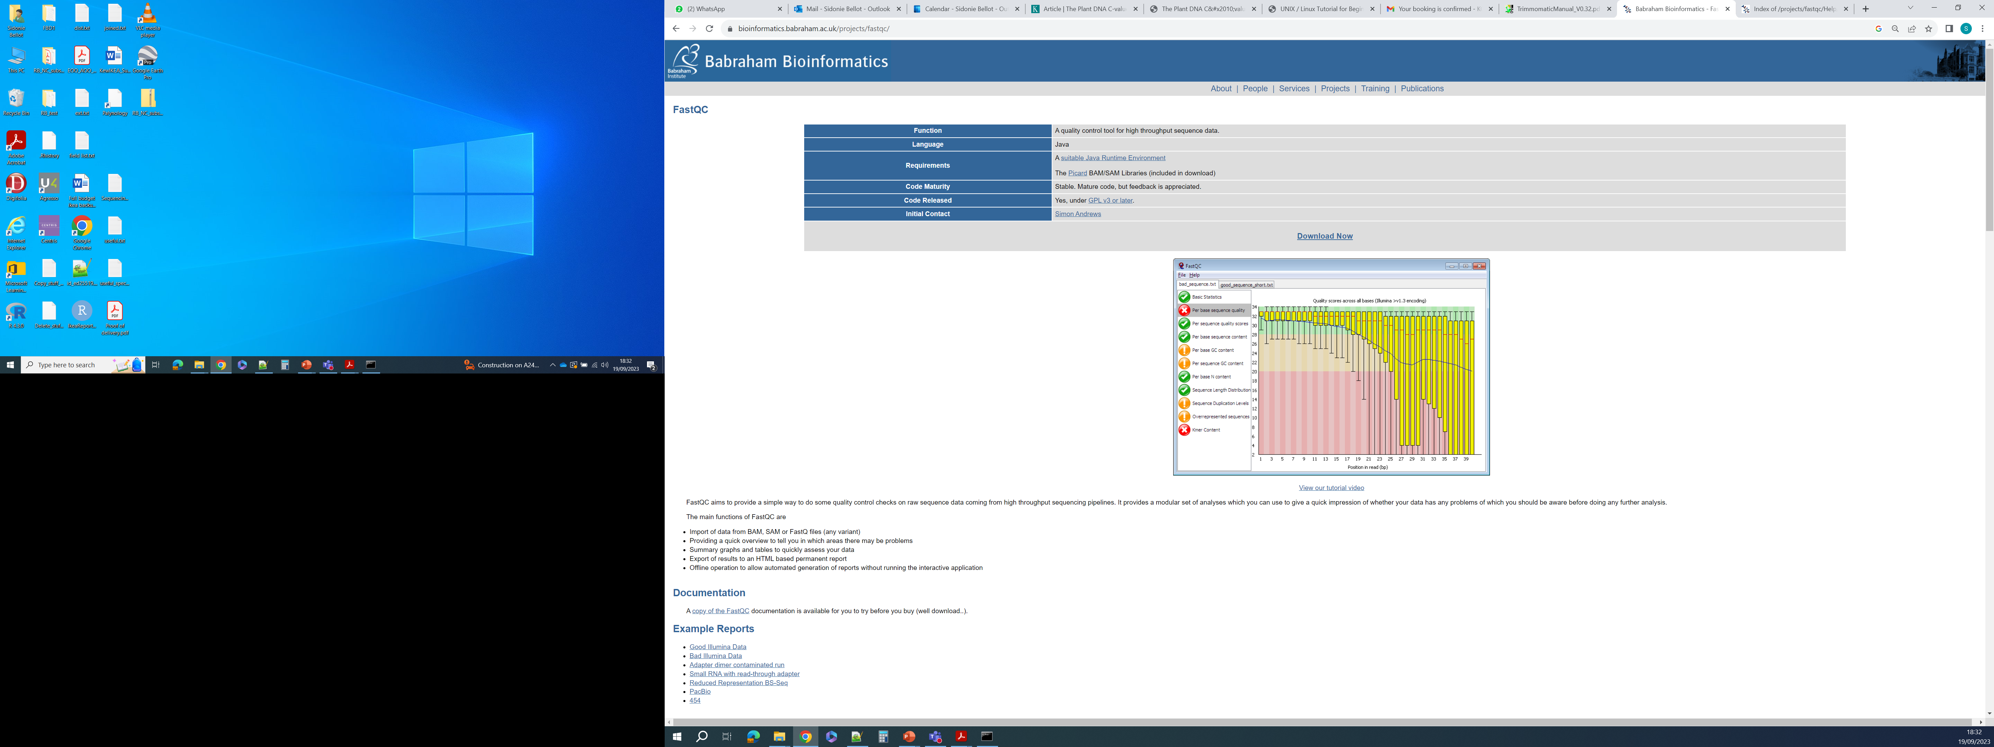
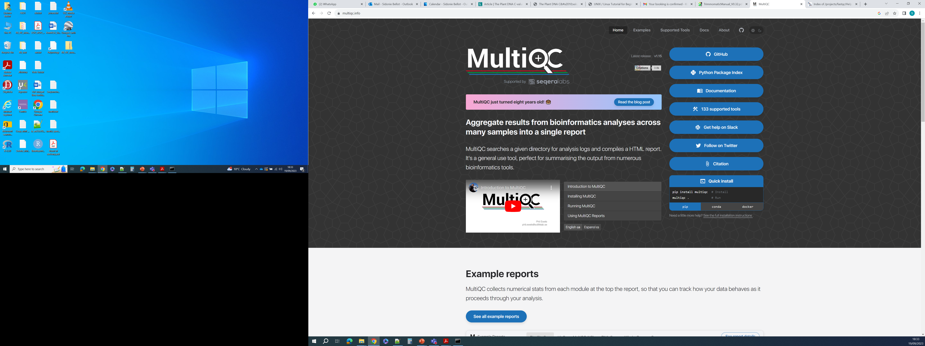
Full details and examples to interpret fastqc reports:
A tool to visualise many fastqc reports at once:

Slide 13
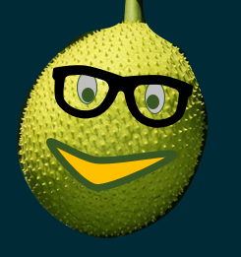

Kopi Break !

Slide 14
Putting loops into practice: Illumina data cleaning
1. Illumina data format
2. Illumina data quality assessment
3. Illumina data quality filtering

Slide 15
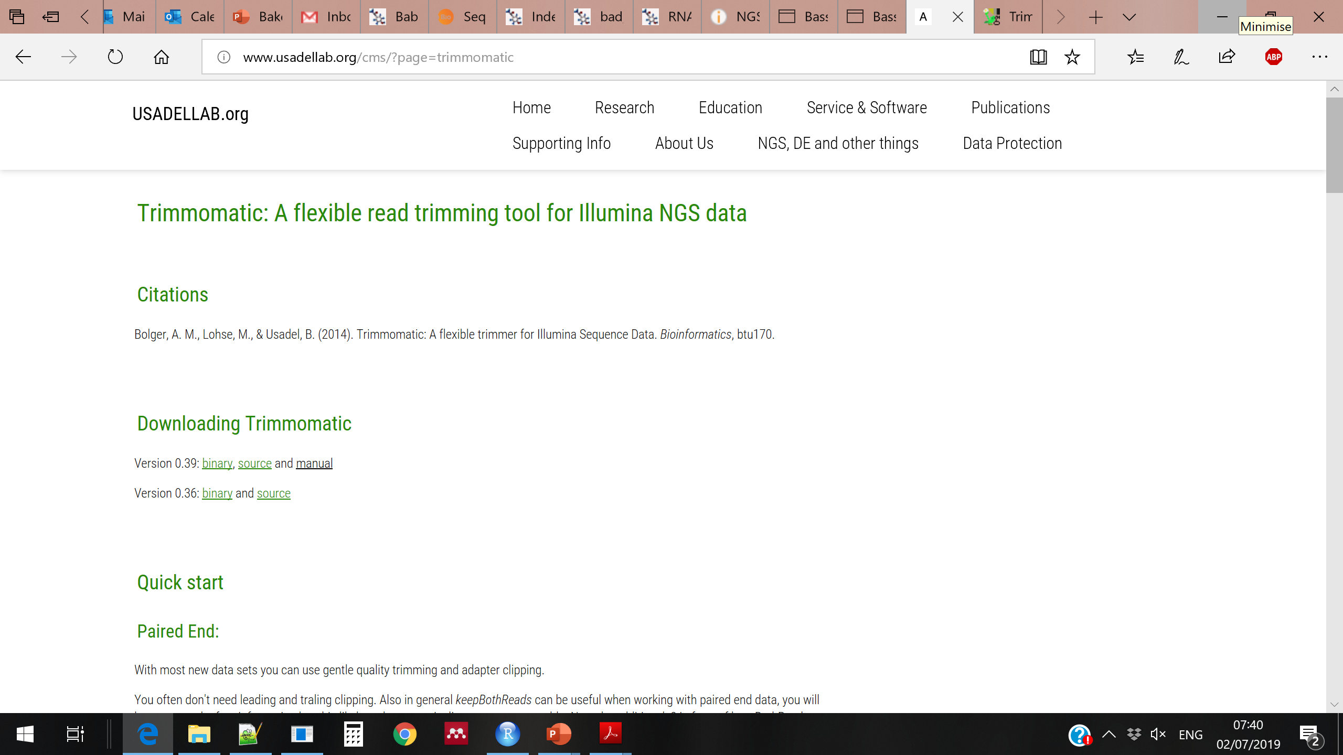
Read trimming and filtering
The process of removing adapters and low-quality bases from the reads is called “read trimming”
In addition to trimming the data, we also want to filter out the reads that will be too short after trimming
The software we use for this is called Trimmomatic:

Slide 16
How to install a software…
Find the official website of the software
Read the documentation section about Download and Installation
Decide what instructions you will follow and what version of the software you will use
In general, this will require to:
Download the software
Move it to a convenient location (e.g. your software directory)
Uncompress the downloaded file
Sometimes instructions will ask you to do more, for instance:
Install other software on which your software of interest depends (these are called dependencies)
run a command such as “make” that will compile your software to make it executable
Put the path to the software in your environment
Sometimes, you can use a software to install other software (packages), for instance conda
Let’s install trimmomatic together…

Slide 17
R1
R2
R1
R2
R1
R2
Adapter removal
Quality filtering / trimming
R1
R2
R1 paired
R2 paired
R1 unpaired
R2 unpaired
Size filtering
4
Output
files

Slide 18
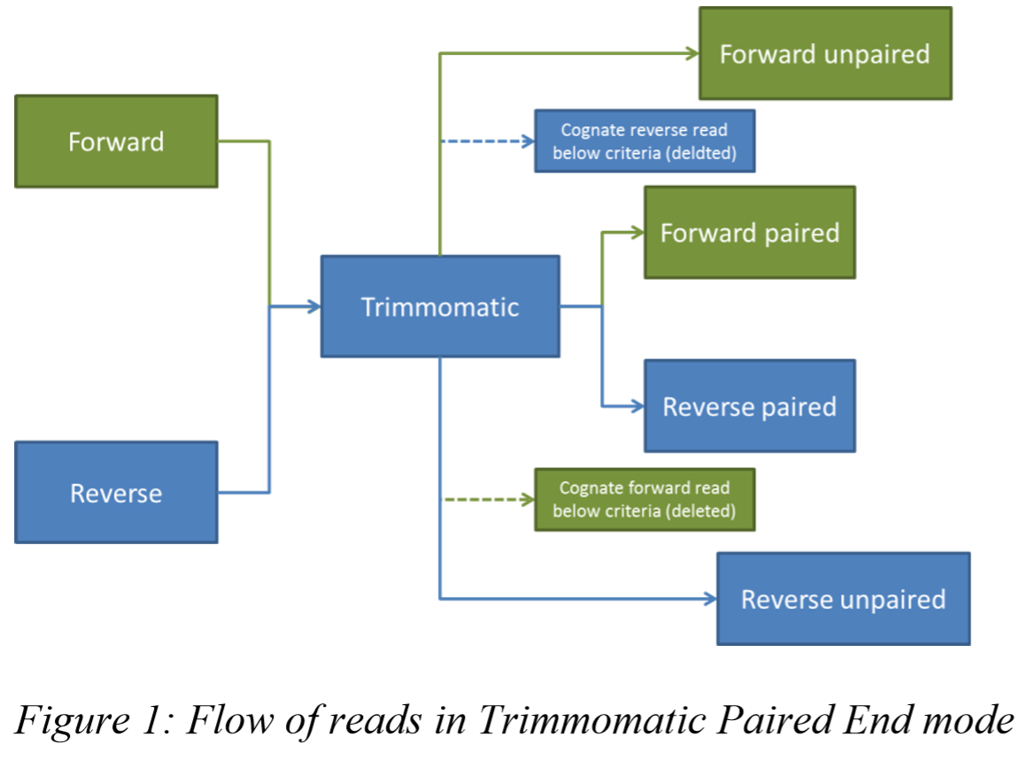
If after the trimming and filtering process one read of the pair is lost and the other is kept, we need to move the remaining read to a file containing “unpaired” trimmed reads.
This is necessary to conserve the symmetry of the R1 and R2 files containing the “paired” trimmed reads corresponding to cases where both reads of a pair survived the trimming.
R1
Same number
of reads
Same number
of reads
R1
Different number
of reads
Trimming + Filtering
R2
R2

Slide 19
Structure of the Trimmomatic command for paired-end reads
Program to use
Mode: paired-end or single end
Tell java to use
trimmomatic
Quality encoding
java -jar trimmomatic-0.39.jar PE -phred33
/PATH/Sample1_R1.fastq /PATH/Sample1_R2.fastq
–baseout Sample1_trimmed
ILLUMINACLIP:/PATH/TruSeq3-PE-2.fa:1:30:7:2:true SLIDINGWINDOW:4:30 LEADING:30 MINLEN:40
Input files and
where they are
Prefix for the
Output files
Path to the file with adapter sequences to look for
Settings to identify
and remove adapters
Settings to remove bases of low quality at the end of the reads
Settings to remove bases of low quality at the beginning of the reads
Reads shorter than this are discarded
The command is normally on a single line
Read the manual to chose and understand the settings!

Slide 20
Exercise: Trim and filter your reads with Trimmomatic
What should be the command to run trimmomatic on your first sample?
Run it to see if it works
Remove the results

Slide 21
Solution: Trimmomatic command on one sample
java -jar trimmomatic-0.39.jar PE -phred33 \
/PATH/Sample1_R1.fastq /PATH/Sample1_R2.fastq \
-baseout Sample1_trimmed\
ILLUMINACLIP:/PATH/adapters/TruSeq3-PE-2.fa:1:30:7:2:true SLIDINGWINDOW:4:30 \ LEADING:30 MINLEN:40
“\” at the end of the lines indicates that there is no new line, ie that all is on the same line
PATH is the absolute path to the files

Slide 22

Makan Siang !

Slide 23
Exercise: Make two more loops
Use a for loop to:
Create a directory for each sample, where each directory is named like the sample
Use another for loop to:
Move the fastqc html files of the samples to their corresponding directories
For instance:
If I have two samples called Sample1 and Sample2, I should obtain:
- One directory called Sample1 and one directory called Sample2
- Directory Sample1 should contain Sample1_R1_fastqc.html and Sample1_R2_fastqc.html
- Directory Sample2 should contain Sample2_R1_fastqc.html and Sample2_R2_fastqc.html
Tips:
Don’t go too fast, try to use the “Make a loop in 9 steps” slide

Slide 24
Write a loop in 9 steps
Write the loop structure (for instance in nano). In the next steps, you will complete it.
for in ; do (); done
2. What will be the output of the loop? A file? Multiple files? Something printed to the screen? Something else?
3. Based on your answer in 2, decide if you should specify a name for the output, and if yes, add it to the loop
for in ; do (>> file_list.txt); done
4. What will be the content of the output: A list of names? A list of values? A set of files with DNA data inside? (draw it!)
5. What should the loop do to generate the output? Iterate through files in a directory? Iterate through lines in a file?...
6. Based on your answer in 5, modify the beginning of the loop so that the computer can find the elements to iterate through
for file in data/P*; do (>> file_list.txt); done
7. What should be the action(s) performed at each iteration? On what should the action(s) be performed?
Should it be performed on a variable defined in step 6? What should be done with the element contained in the variable?
8. Based on your answer in 7, provide the command to perform the action(s):
for file in data/P*; do (echo ${file/.fastq}_blabla >> file_list.txt); done
9. Read the command: does it make sense? Are you in the right directory to run it? If yes, try it, and learn from the errors ☺

Slide 25
Solution: Make two more loops
Use a for loop to:
Create a directory for each sample, where each directory is named like the sample
for file in *R1.fastq; do (mkdir ${file/_R1*}); done
Use another for loop to:
Move the fastqc html files of the samples to their corresponding directories
for file in *.html; do (mv $file ${file/_R1*}/); done

Slide 26
R1
R2
R1
R2
R1
R2
Adapter removal
Quality filtering / trimming
R1
R2
R1 paired
R2 paired
R1 unpaired
R2 unpaired
Size filtering
4
Output
files

Slide 27
Structure of the Trimmomatic command for paired-end reads
Program to use
Mode: paired-end or single end
Tell java to use
trimmomatic
Quality encoding
java -jar trimmomatic-0.39.jar PE -phred33
/PATH/Sample1_R1.fastq /PATH/Sample1_R2.fastq
–baseout Sample1_trimmed
ILLUMINACLIP:/PATH/TruSeq3-PE-2.fa:1:30:7:2:true SLIDINGWINDOW:4:30 LEADING:30 MINLEN:40
Input files and
where they are
Prefix for the
Output files
Path to the file with adapter sequences to look for
Settings to identify
and remove adapters
Settings to remove bases of low quality at the end of the reads
Settings to remove bases of low quality at the beginning of the reads
Reads shorter than this are discarded
The command is normally on a single line
Read the manual to chose and understand the settings!

Slide 28
Exercise: Trim and filter your reads with Trimmomatic
What should be the command to run trimmomatic on all your samples?
(hint: use a for loop and wild cards)
Run it
How can you check if the trimming worked well?
Do it

Slide 29
Solution: Trimmomatic command on all samples (example 1)
One sample (reminder):
java -jar trimmomatic-0.39.jar PE -phred33 \
/PATH/Sample1_R1.fastq /PATH/Sample1_R2.fastq \
-baseout Sample1_trimmed\
ILLUMINACLIP:/PATH/adapters/TruSeq3-PE-2.fa:1:30:7:2:true SLIDINGWINDOW:4:30 \ LEADING:30 MINLEN:40
Many samples: same command structure but we use a for loop to process each sample one after the other
The difficulty here is that we need to process R1 and R2 of one sample together, so we cannot just loop over all files. One way is to loop over the R1 files only and call the corresponding R2 file each time:
for f in /PATH/*_R1.fastq; do ( \
java -jar trimmomatic-0.39.jar PE -phred33 \
/PATH/$f /PATH/${f/_R1.fastq}_R2.fastq \
-baseout /PATH/${f/_R1.fastq}_trimmed \
ILLUMINACLIP:/PATH/adapters/TruSeq3-PE-2.fa:1:30:7:2:true SLIDINGWINDOW:4:30 \ LEADING:30 MINLEN:40 \
); done
There are many other ways to obtain the same result

Slide 30
Solution: Trimmomatic command on all samples (example 2)
Another way is to loop over the samples, not the files, by defining the sample name based on a sample list
This time, we use a “while” loop, instead of a “for” loop, but the idea is similar:
while read sample
do
java -jar trimmomatic-0.39.jar PE -phred33 \
/PATH/$sample_R1.fastq /PATH/$sample_R2.fastq \
-baseout $sample_trimmed\
ILLUMINACLIP:/PATH/adapters/TruSeq3-PE-2.fa:1:30:7:2:true SLIDINGWINDOW:4:30 \ LEADING:30 MINLEN:40
done < sample_name_list.txt
Sample_name_list.txt contains the sample names, one per line, such as:
Sample1
Sample2

Slide 31
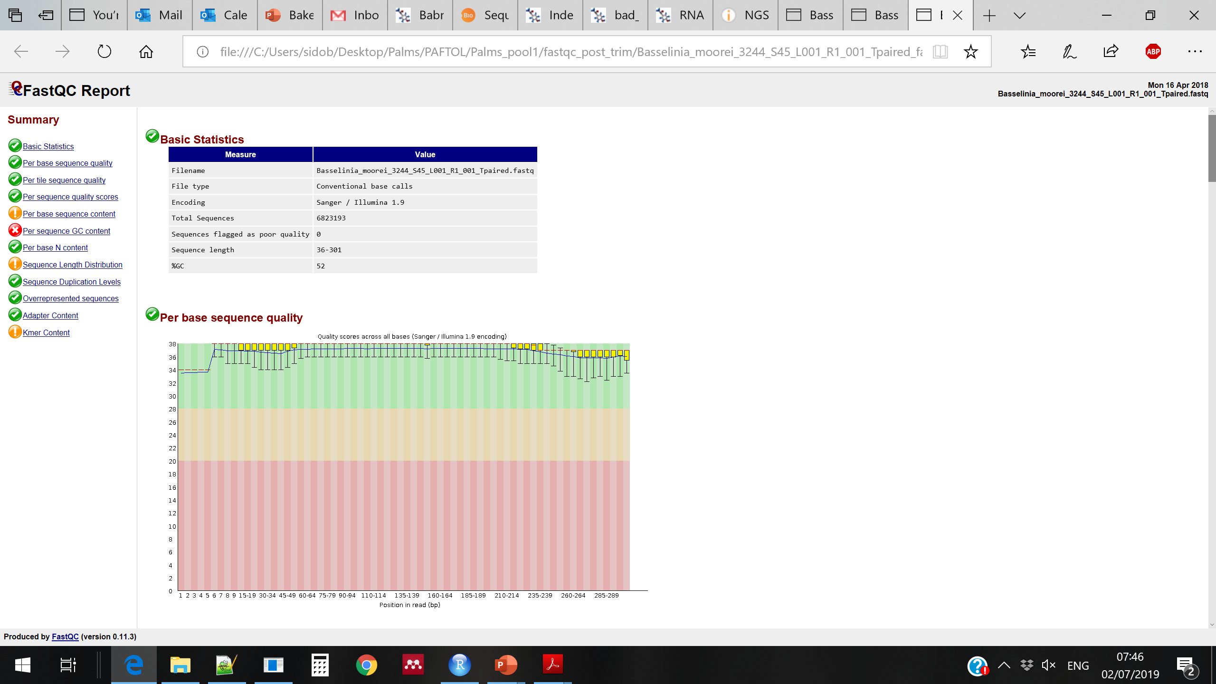
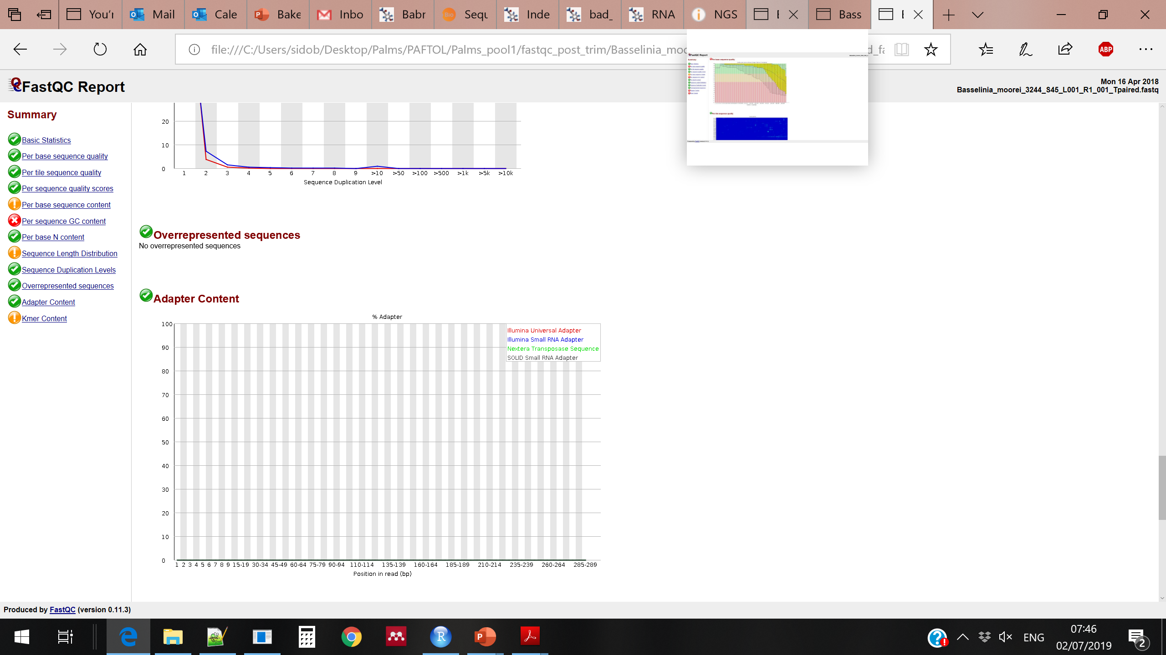
Data is ready for further analyses when only reliable data is left and adapters are removed
Multiple trials are often needed to find the right Trimmomatic settings, especially for new projects.
When samples have very heterogenous data quality (e.g. data from herbarium vs freshly collected specimens), they may need to be processed in different batches, using different settings for each batch.

